Slide 1
Probability and Random Processes
Basic Concepts

Slide 2
Objectives
Review set theory
Explore random experiments and probabilities
Examine conditional probability
Examine independence
Review law of total probability
Review Bayes’ rule
Explore conditional independence

Slide 3
Rationale
An exploration of the basic concepts of probability will provide a
foundation for discussion.
Mathematical concepts are necessary for understanding probability
theory.
This lesson focuses on random experiments and the axioms of probability.
You will explore discrete and continuous probability models, before
discussing conditional probability.

Slide 4




Review of Set Theory
A set is an unordered collection of things (elements).
•
•
•
•

Slide 5


Review of Set Theory
The set of natural numbers,
The set of integers,
The set of real number

Slide 6






Review of Set Theory
Set is a subset of set if every element of is also an element of We write where " " indicates "subset ".
Example:
•
•

Slide 7









Review of Set Theory
if and only if and
Example:
Universal set:
The set of all things that we could possibly consider in a given context.
Universal set
Null set ; For any set

Slide 8

Venn Diagrams
In a Venn diagram any set is depicted by a closed surface.

Slide 9





Set Operations
Union: The union of two sets all objects in or | and | is denoted by and consist of
if and only if |  | or

Slide 10

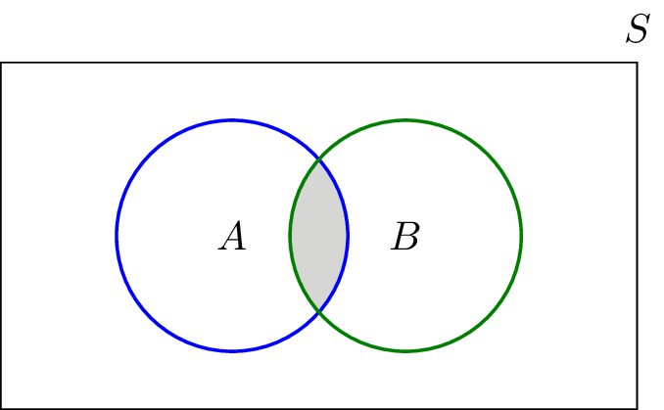
Set Operations
Intersection:
The intersection of two sets
objects in both and
and is denoted by
and consist of all

Slide 11




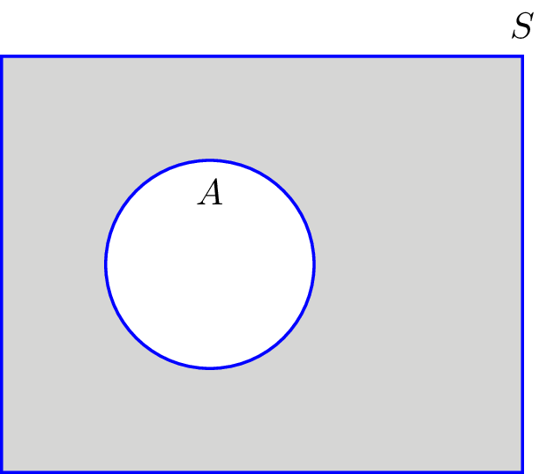


Set Operations
Complement:
The complement of a set
that are Not in
denoted by
is the set of all elements in

Slide 12

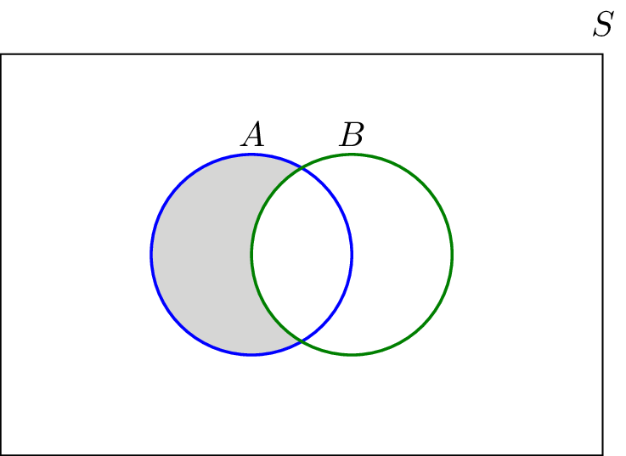

Set Operations
Difference (subtraction):
The subtraction of set from in
is all elements in
that are not

Slide 13






Set Operations
Mutually exclusive set (disjoint):
Two sets and are mutually exclusive (or disjoint) if
are m.e. if

Slide 14



Set Operations
Partition:
A collection of sets
a) They are disjoint . b)
is a Partition of if

Slide 15
Set Operations
Theorem : De Morgan's law

Slide 16





Set Operations
Example: Let | and
a) b) |  | c)
d) f) |  | g)
The sets |  | form a partition of

Slide 17
Set Operations
Theorem : Distributive law
•
•

Slide 18
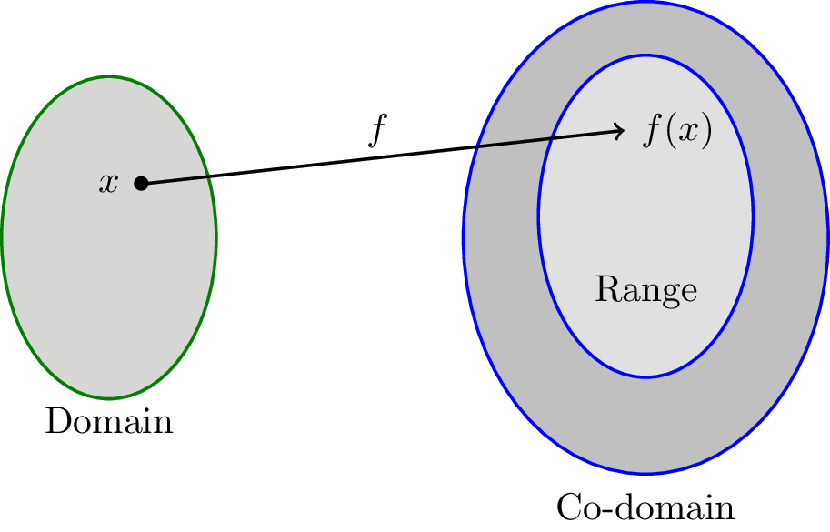






Functions
Domain Co-domain
Range: the set of all the possible values of
(Range
)

Slide 19



Functions
Example:
Consider the function
defined as
one-to-one (invertible):

Slide 20


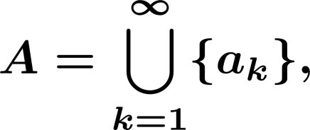


Countable and Uncountable Sets
Cardinality of a set is the number of elements in
set is finite if
set if countable if it is finite Or the elements of
listed in a sequence that is,
can be enumerated or
Ex:
is countable.

Slide 21

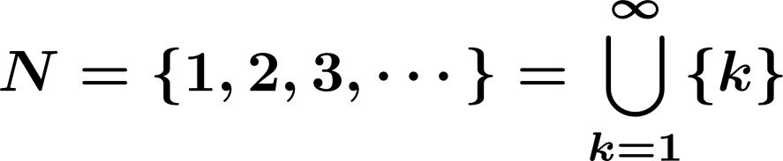
Countable and Uncountable Sets
Uncountable: Not countable.
e.g.,
Equivalently: set is countably infinite if it is in one-to-one correspondence
with

Slide 22


Countable and Uncountable Sets
Example:
(set of integers) is countable (countably infinite).
Because

Slide 23
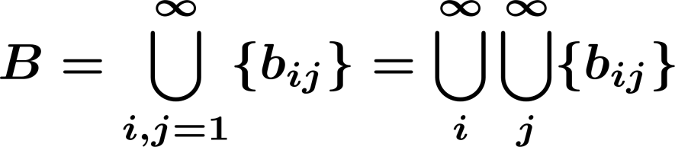
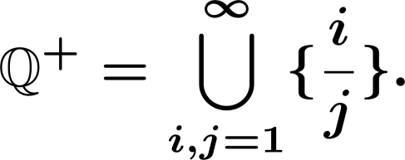
Countable and Uncountable Sets
Example:
Show that a set of the form
is countable.
Example:
Show that the positive rational number form a countable set:

Slide 24



Countable and Uncountable Sets
But is not countable.
In fact, any interval where is not countable.

Slide 25
Random experiment
Random experiment: A phenomenon whose outcome cannot be predicted with certainty, such as
Random experiment:
Roll a die
Roll a die three times
Flip a coin

Slide 26
Random experiment
Outcome:
An outcome is the result of a random experiment.
Roll a die 3
Roll a die 3 times (2, 3, 6)

Slide 27



Random experiment
Events:
An event is collection of possible outcomes.
Roll a die (Event=E)

Slide 28

Random experiment
Sample Space:
The sample space is the set of all possible outcomes.
Roll a die:
random experiment
Roll a die three times
an outcome

Slide 29
Random experiment
Event
Sample space
Outcome
Set
Universal Set Element
We say that an event
element of
occurs if the outcome of the experiment is an

Slide 30








Random experiment
Partition:
A partition is a collectively exhaustive, and mutually exclusive set of events, i.e.,
is a Partition if

Slide 31





Probability
Event
We assign a probability
Probability of
to every event
The portion of times event is observed in a large number of runs of
the experiment.
events

Slide 32




Probability
Axioms of Probability
Definition. A probability measure
is a function that maps events in the
sample space to real numbers. Such that:
For any event
Probability of the sample space is
For any countable collection
of disjoint events

Slide 33
Probability
Roll a fair die (fair: outcomes are equally likely).
disjoint
3rd axiom:

Slide 34
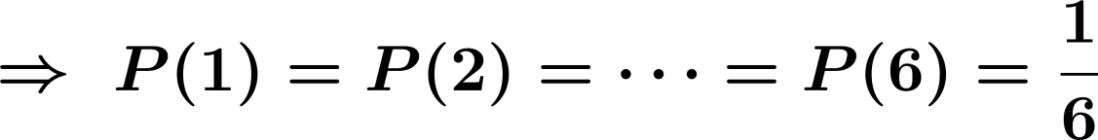


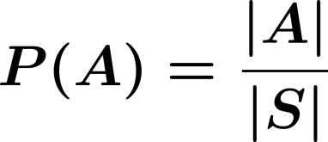
Probability
disjoint
Equally likely outcomes:

Slide 35



Probability
Using the axioms:
1) what is
disjoint

Slide 36





Probability
2)
empty
3)

Slide 37
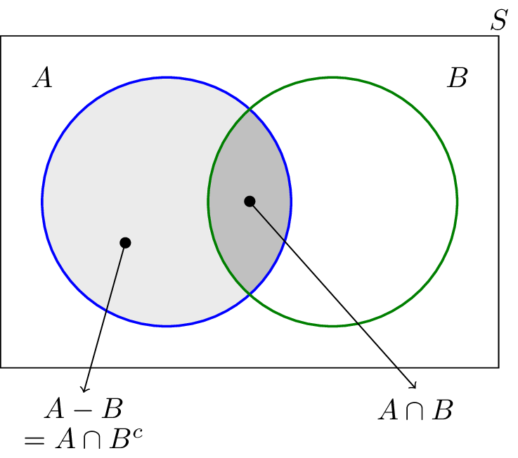
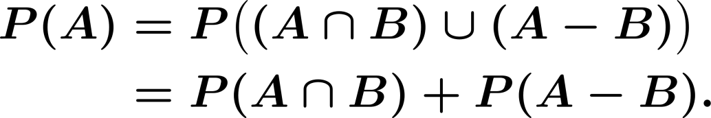
Probability
4)

Slide 38



Probability
5)
Use Venn diagram.
6)

Slide 39



Probability
Example:
Roll a die twice and observed
and

Slide 40


Sample Space
Sample Space:
a) Countable:
Discrete Probability Space

Slide 41
Sample Space
b) Uncountable
Continuous Probability Space

Slide 42



Continuous Probability Space
Example: I choose a point completely at random in
a)
b)
c)
d)

Slide 43
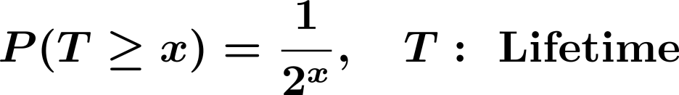



Continuous Probability Space
Key point: Axioms of Probability applies to continuous probability spaces.
Example: Suppose we know that the probability that a certain machine lasts
more than or equal to years is :
Find the following sets: a)
b)
c)

Slide 44


Conditional Probability
Suppose that in a certain city, 0.3 percent of the days are rainy.
The probability that it rains given that it is cloudy might be:
Conditional probability: The probability
given

Slide 45

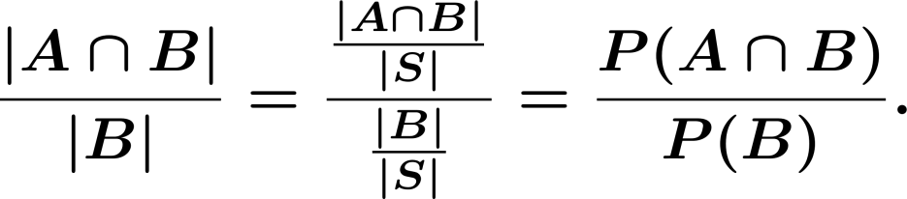
Conditional Probability
Example. Roll a fair die, what is the probability that the outcome is an even
number given it was less than or equal to 3, i.e.,
Note:

Slide 46
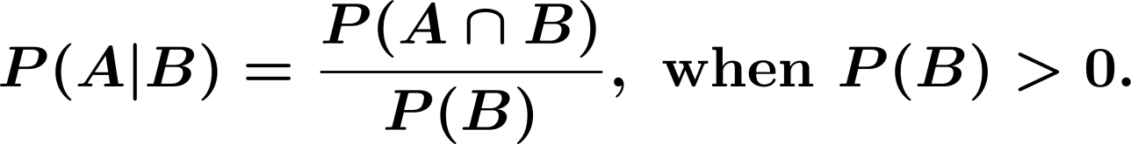
Conditional Probability
Definition: The Conditional Probability occurred given that has occurred is given by
, the probability that

Slide 47

Conditional Probability
If and are two events in a sample space
then

Slide 48


Conditional Probability
Conditional probability satisfies the probability axioms :
For any event
Conditional probability of given is

Slide 49
Conditional Probability
c) If are disjoint events, then

Slide 50


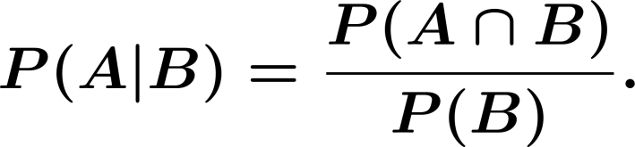
Conditional Probability
Example. Roll two dice
: 3 dots are shown at least on one die
Find

Slide 51


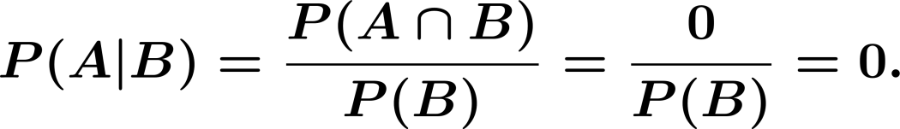

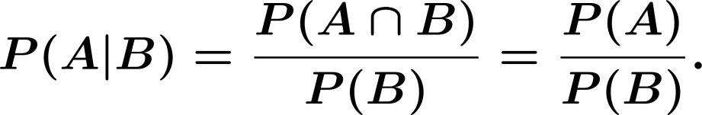
Conditional Probability
Special cases:
1) and are disjoint:
2)

Slide 52

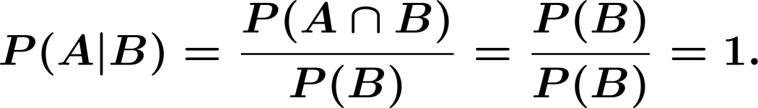
Conditional Probability
3)

Slide 53



Conditional Probability
Example. Roll a die, what is the probability that it is larger than or equal to 5, given that it is an even number ?
, even number

Slide 54

Conditional Probability
Definition: Two events
and are independent if and only if
equivalently

Slide 55

Conditional Probability
Warning!
Disjoint (mutually exclusive) Disjoint:
Independent:
Independent

Slide 56


Conditional Probability
Suppose and are disjoint: If
If disjoint
Not independent.
These are completely different concepts. When two events A and B are disjoint
it means that if one of them occurs, the other one cannot occur. Thus, event A
usually gives a lot of information about event B which means that they cannot
be independent.

Slide 57




Conditional Probability
Example:
independent
Event that there is a connection from node
to node

Slide 58




Conditional Probability
Remark:
1)
2) If are independent, then
are independent.
are independent.
are independent.

Slide 59



Conditional Probability
Example:
independent
Find
Note that
are independent.

Slide 60
Conditional Probability
If and are two events in a sample space probability of given is defined as
then the conditional

Slide 61
Independence
Two events and are independent if and only if

Slide 62


Independence
Three events and
hold
are independent if all of the following conditions

Slide 63


Independence
Example.
Two darts players throw alternately at a board and the first to score a bull wins. On each of their throws player has probability and player of success; the result of different throws are independent. If starts, calculate the probability that he/she wins.

Slide 64


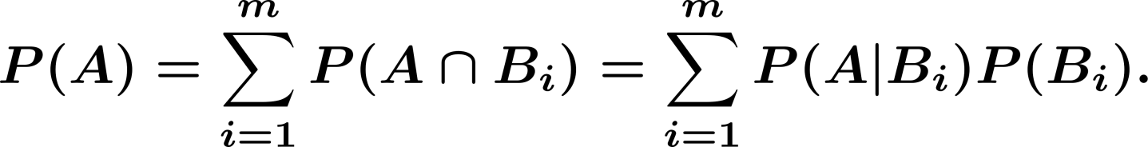
Law of Total Probability
Let
For any event
be a partition of the sample space we have
with

Slide 65

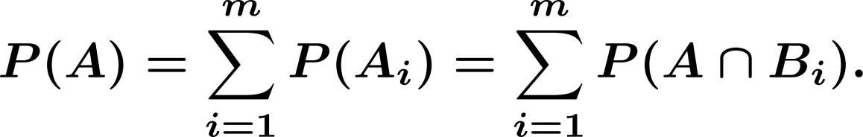
Law of Total Probability

Slide 66



Law of Total Probability
Example:
Three coins are in a bag:
Coin 1: probability of heads is 0.9.
Coin 2: probability of heads is 0.6.
Coin 3: probability of heads is 0.3.
I draw a coin at random and toss it. What is the probability of heads?

Slide 67

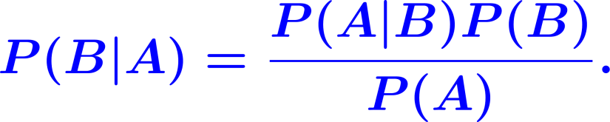
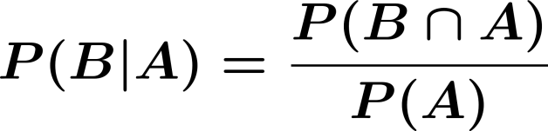
Bayes' Rule
For any two events and , where
, we have

Slide 68

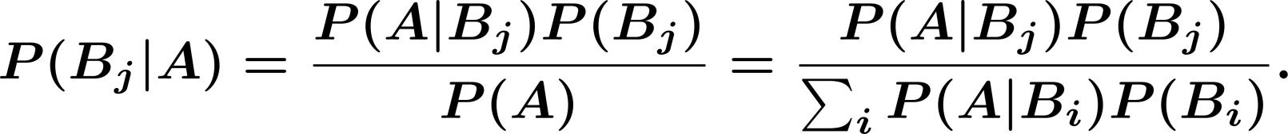
Bayes' Rule
If with
is a partition of the sample space we have
, and
is any event

Slide 69
Bayes' Rule
Example.
In the previous problem, suppose that we know the result is heads; what is the probability that Coin 1 was chosen?

Slide 70


Bayes' Rule
Example. In a communication system a zero or a one is transmitted with the
probability or
respectively. Due to the noise in the channel, a zero can be received as a one, with probability and a one can be received as a zero also with probability . A one was observed, what is the probability that a one was transmitted?

Slide 71

Conditional Independence
Two events and are independent if and only if
Two events
only if
and are conditionally independent given an event if and

Slide 72
Chain Rule for Conditional Probability
We can extend this to 3 or more events:

Slide 73
Summary
You explored the basic concepts of probability that will provide a foundation for discussion of probability. You also reviewed mathematical concepts needed to understand probability theory. You had the opportunity to examine random experiments and the axioms of probability. Additionally, you explored discrete and continuous probability models and discussed conditional probability.

